Slide 1
S1223 Airfoil and Aircraft
2.3” Thickness
TR:
FB:

Slide 2
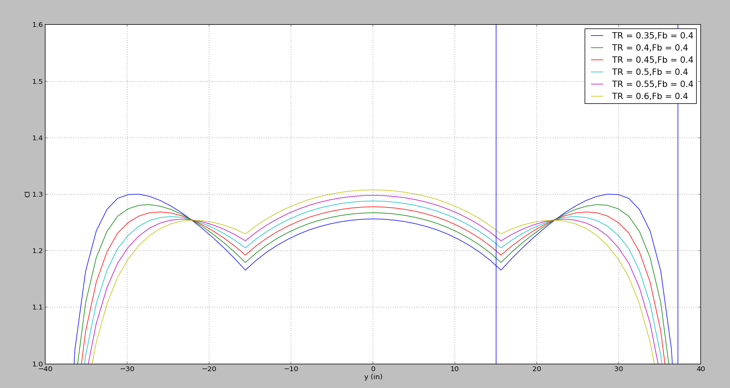
TR trades

Slide 3
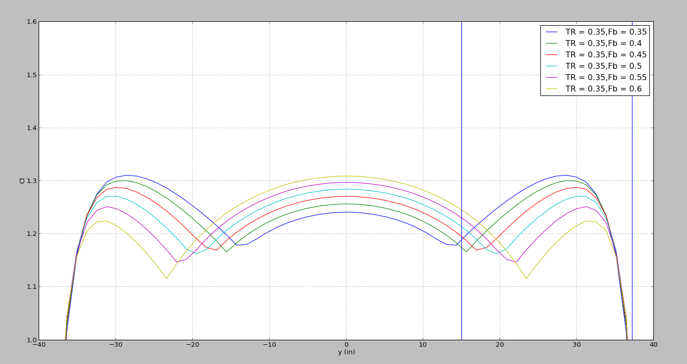
FB Trades

Slide 4
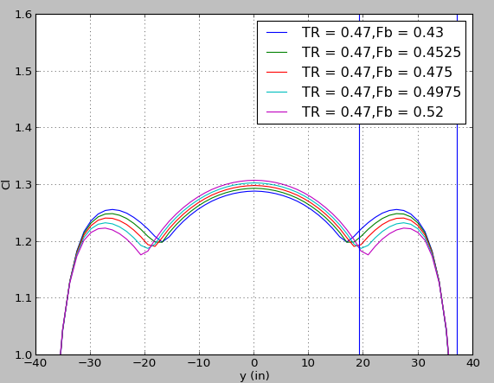
S1223 TR and FB trades

Slide 5
Final Numbers
TR: 0.47
FB: 0.5

Slide 6
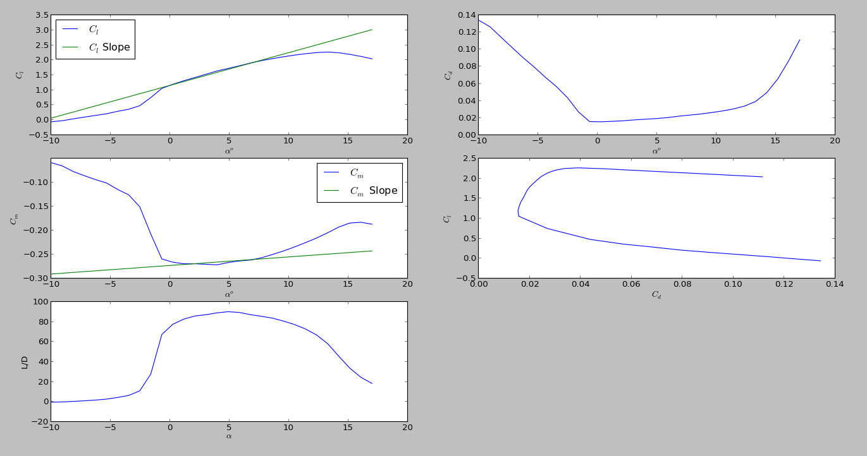
S1223 Linear Approx.

Slide 7
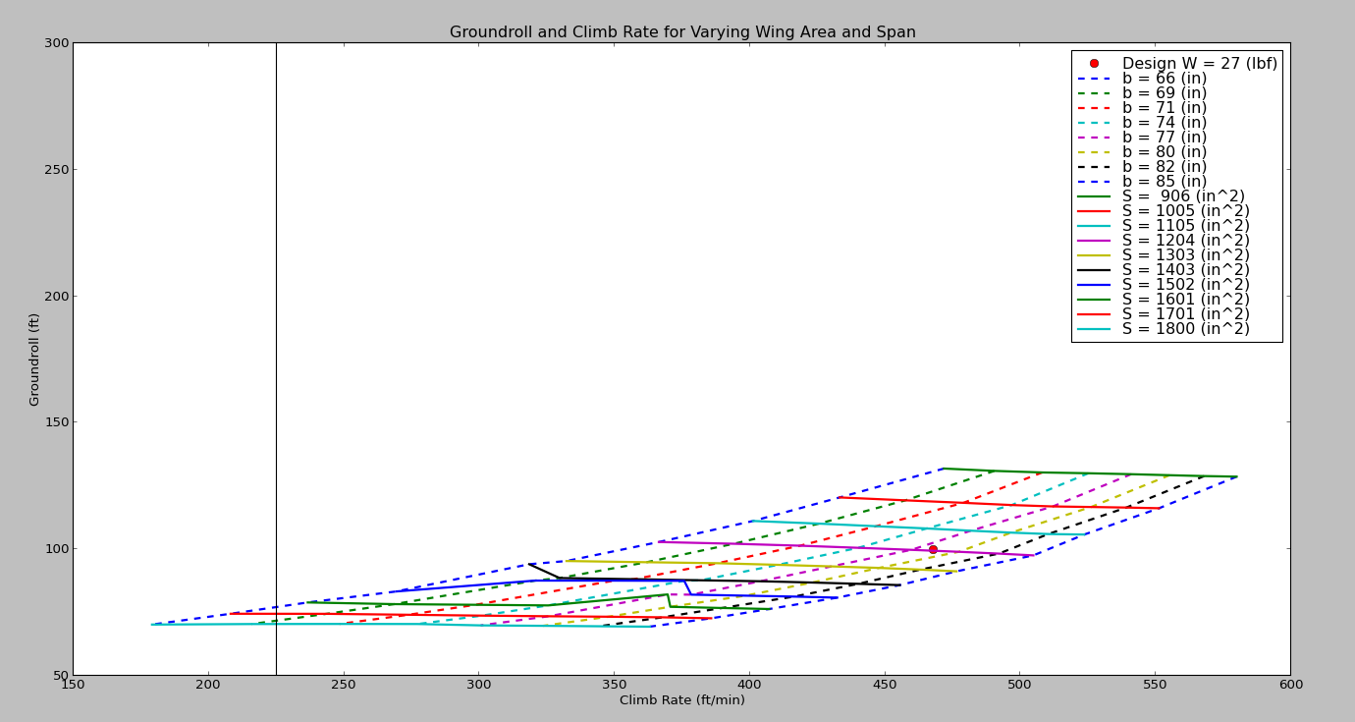
S1223 Wing sizing trade

Slide 8
Reasons for choosing b and S
When running the wing trade studies the codes say that a span of 66” and 906 in2 will work
However running the codes at b=66 and S=906 shows that that this size of a wing will not get the a/c airborne.
After running the a/c file individually at each b and s for the “best/lowest” take off conditions a wing span and wing area was set.

Slide 9
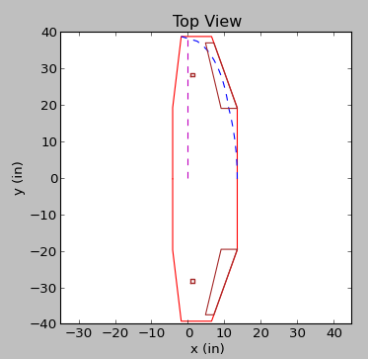
S1223 Wing Planform

Slide 10
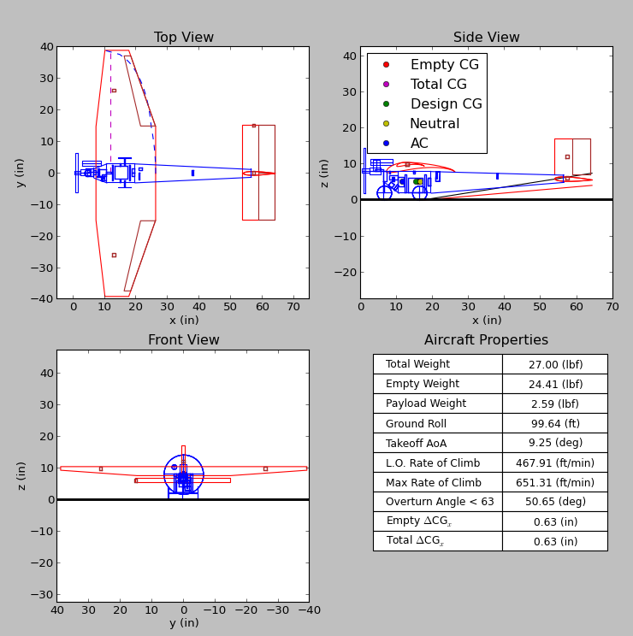
S1223 Aircraft

Slide 11
Wing Sizing
b: 78 in
S: 1200 in^2
Wing lift at lift off: 30.66 lbf
Chord: 18.9
Thickness 2.294”
Weight 2.25 lbf

Slide 12
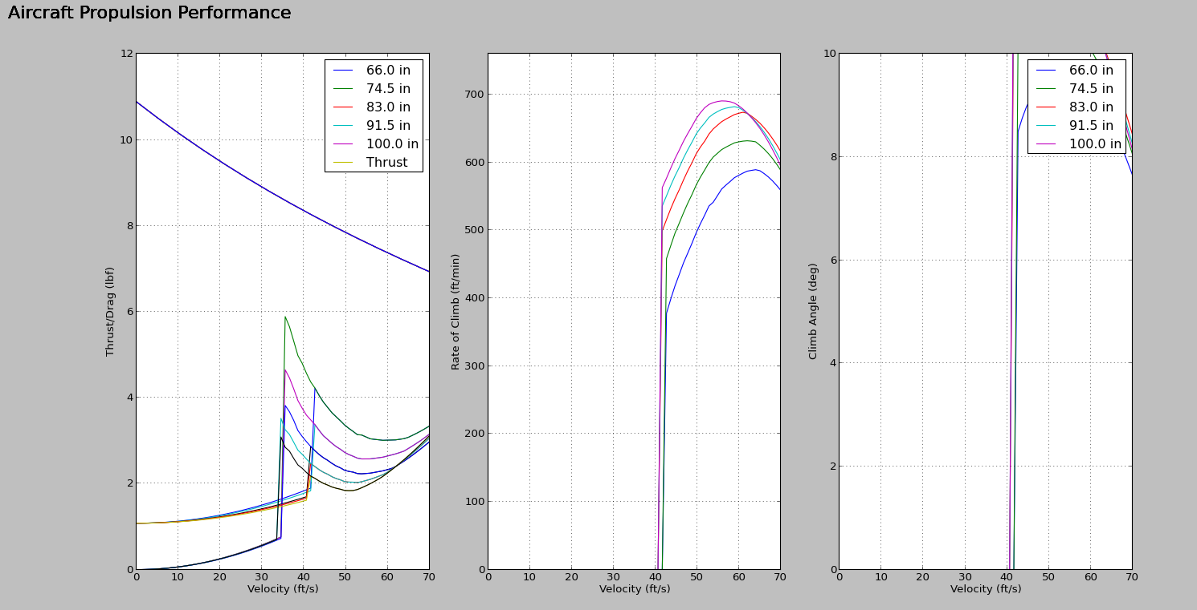
Ground roll vs. Span

Slide 13
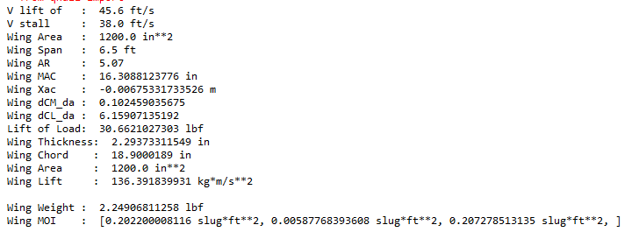
Wing stats

Slide 14
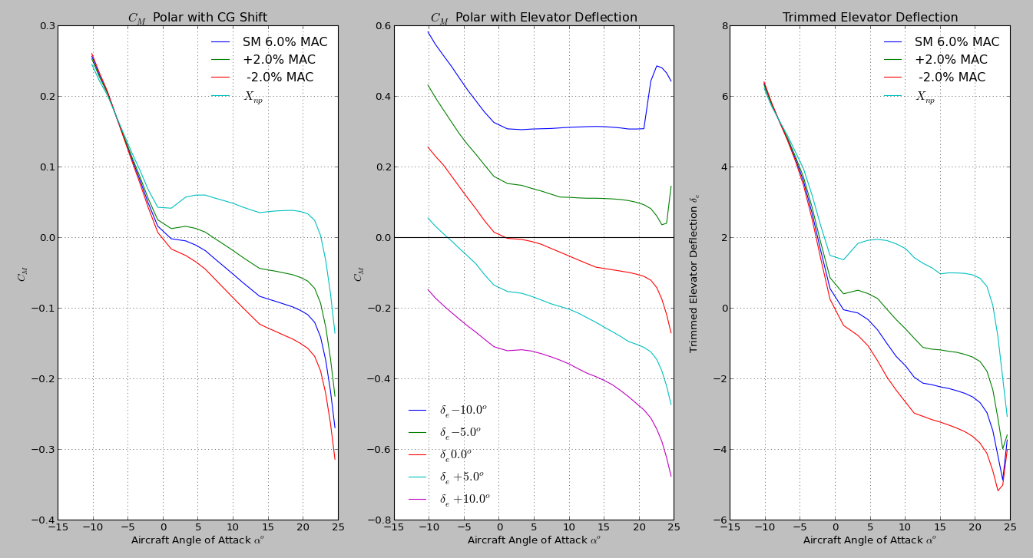
Long. Stability

Slide 15
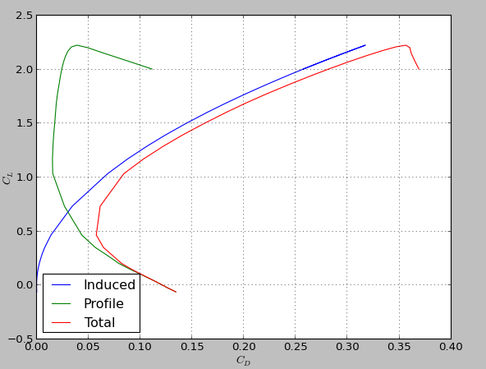
Drag profiles

Slide 16
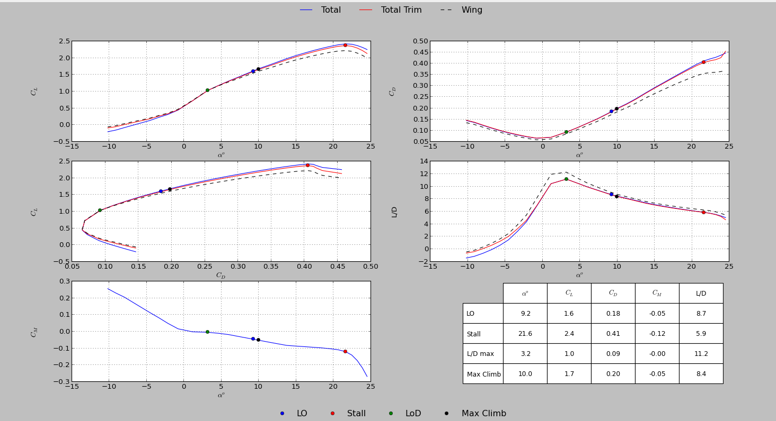
S1223 Aerodynamics

Slide 17
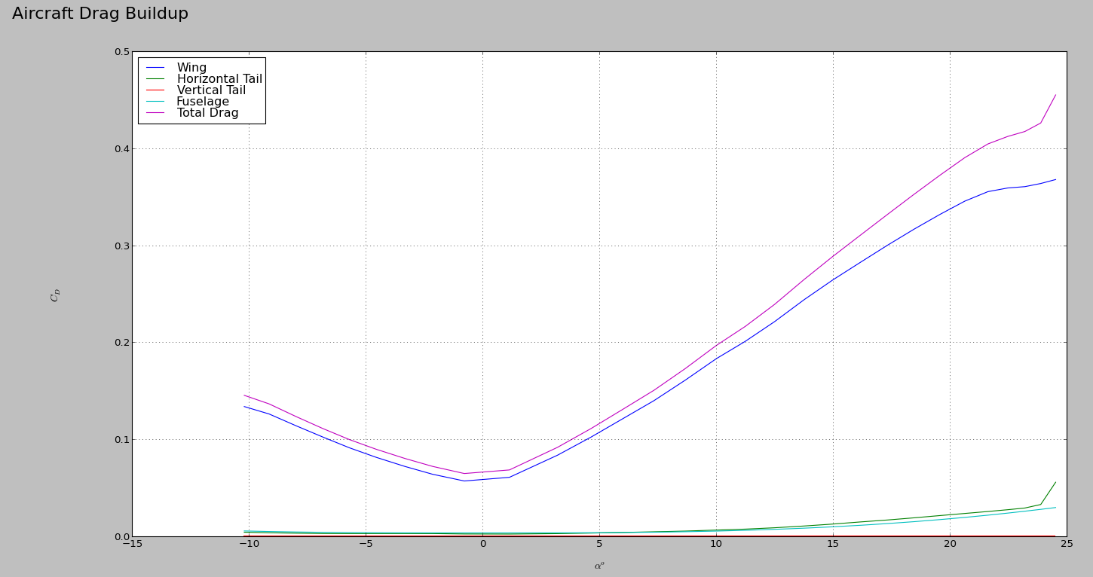
Aircraft drag build up

Slide 18
Item | Value | Coefficient
Span | 78 | In
Area | 1200 | In2
Rect Chord | 18.9 | In
Rect span | 14.82 | In
Wing Tip Chord | 7.56 | In
TR angle | 7.1 | Deg
Wing tip delta LE | 3 | In
Lift at LO | 30.66 | Lbf
Max thickness | 2.29 | In
Wing Weight | 2.25 | Lbf
A/c weight | 24.41 | Lbf
Tail mac’s behind wing ac | 2.5 | MAC
MAC | 16.31 | In
Airfoil | S1223

